Slide 1




Computer Networks
Application Layer Functionality and Protocols
Lecturer: Sura F. Ismail
Lecture Three.
Second Class.
Time: 9: 30- 11:30
Department: Informatics Systems Management (ISM)

Slide 2
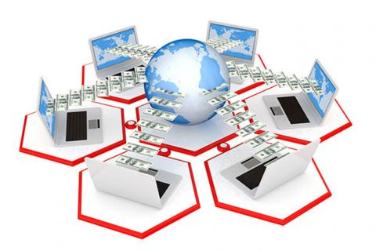
Outline
Outline
Overview
Applications: The Interface Between the Networks
Making Provisions for Applications and Services
6. Trends in Networking

Slide 3
1. Overview
Outline
The world experiences the Internet through the use of the World Wide Web, e-mail, and file-sharing programs. These applications, as well as others, provide the human interface to the underlying network, allowing you to send and receive information with relative ease. Most of the applications are intuitive; they can be accessed and used without the need to know how they work.
The OSI model is a seven-layer model, designed to help explain the flow of information from layer to layer. This lecture focuses on the role of Layer 7, the application layer.

Slide 4
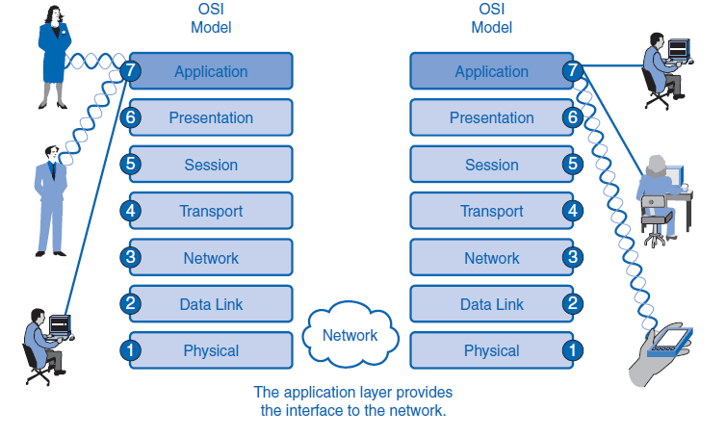
1. Overview
Outline

Slide 5
2. Applications: The Interface Between the Networks
Outline
This section introduces two important concepts:
Application layer: The application layer of the OSI model provides the first step of getting data onto the network.
Application software: Applications are the software programs used by people to communicate over the network. Examples of application software, including HTTP, FTP, e-mail, and others, are used to explain the differences between these two concepts.
The application layer, Layer 7, is the top layer of both the OSI and TCP/IP models.
Layer 7 provides the interface between the applications you use to communicate and the underlying network over which your messages are transmitted.
Application layer protocols are used to exchange data between programs running on the source and destination hosts.
Although the TCP/IP protocol suite was developed prior to the definition of the OSI model, the functionality of the TCP/IP application layer protocols fits roughly into the framework of the top three layers of the OSI model: application, presentation, and session.

Slide 6
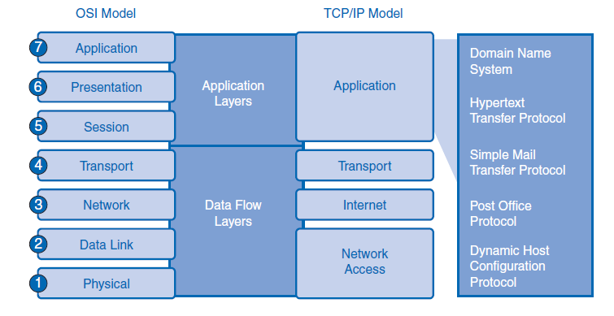
2. Applications: The Interface Between the Networks
Outline

Slide 7
2. Applications: The Interface Between the Networks
Outline
Presentation Layer
The presentation layer has three primary functions:
Coding and conversion of application layer data to ensure that data from the source device can be interpreted by the appropriate application on the destination device
Compression of the data in a manner that can be decompressed by the destination device
Encryption of the data for transmission and decryption of data upon receipt by the destination

Slide 8
2. Applications: The Interface Between the Networks
Outline
Presentation layer implementations are not typically associated with a particular protocol stack. The standards for video and graphics are examples. Some well-known standards for video include QuickTime and Motion Picture Experts Group (MPEG). QuickTime is an Apple Computer specification for video and audio, and MPEG is a standard for video compression and coding. Among the well-known graphic image formats are Graphics Interchange Format (GIF), Joint Photographic Experts Group (JPEG), and Tagged Image File Format (TIFF). GIF and JPEG are compression and coding standards for graphic images, and TIFF is a standard coding format for graphic images.
Session Layer
Functions at the session layer create and maintain dialogs between source and destination applications. The session layer handles the exchange of information to initiate dialogs and keep them active, and to restart sessions that are disrupted or idle for a long period of time.

Slide 9
2. Applications: The Interface Between the Networks
Outline
TCP/IP Application Layer Protocols
The most widely known TCP/IP application layer protocols are those that provide the exchange of user information. Among these TCP/IP protocols are the following:
Domain Name System (DNS) is used to resolve Internet names to IP addresses.
Hypertext Transfer Protocol (HTTP) is used to transfer files that make up the web pages of the World Wide Web.
Simple Mail Transfer Protocol (SMTP) is used for the transfer of mail messages and attachments.
Telnet, a terminal emulation protocol, is used to provide remote access to servers and networking devices.
File Transfer Protocol (FTP) is used for interactive file transfer between systems.
The protocols in the TCP/IP suite are generally defined by Requests for Comments (RFC). The Internet Engineering Task Force (IETF) maintains the RFCs as the standards for the TCP/IP suite.

Slide 10
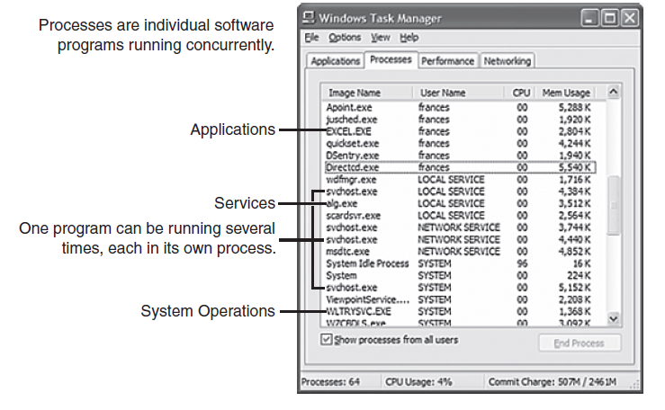
2. Applications: The Interface Between the Networks
Outline
Application Layer Software
The functions associated with the application layer protocols in both the OSI and the TCP/IP models enable the human network to interface with the underlying data network. When you open a web browser or an instant message window, an application is started, and the program is put into the device memory, where it is executed. Each executing program loaded on a device is referred to as a process. Within the application layer, there are two forms of software programs or processes that provide access to the network: applications and services.

Slide 11
3. Making Provisions for Applications and Services
Outline
When people attempt to access information on their device, whether it is a PC, laptop, PDA, cell phone, or some other device connected to a network, the data might not be physically stored on their device. If that is the case, a request to access that information must be made to the device where the data resides. The following sections cover three topics that will help you understand how the request for data can occur and how the request is filled:
Client/server model
Application layer services and protocols
Peer-to-peer networking and applications

Slide 12
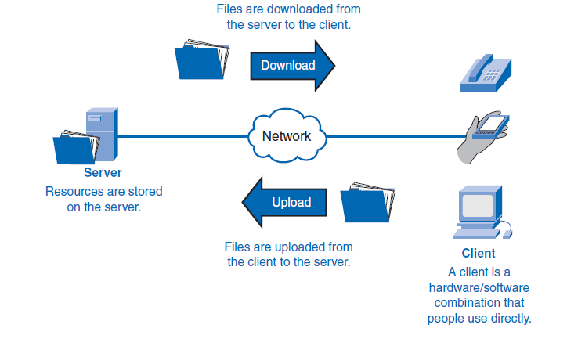
3. Making Provisions for Applications and Services
Outline
Client/Server Model
In the client/server model, the device requesting the information is called a client and the device responding to the request is called a server. Client and server processes are considered to be in the application layer. The client begins the exchange by requesting data from the server, which responds by sending one or more streams of data to the client. Application layer protocols describe the design of the requests and responses between clients and servers. In addition to the actual data transfer, this exchange can require control information, such as user authentication and the identification of a data file to be transferred.

Slide 13
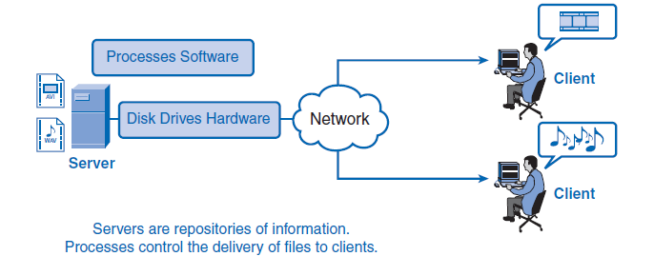
3. Making Provisions for Applications and Services
Outline
Servers
In a general networking context, any device that responds to requests from client applications is functioning as a server. A server is usually a computer that contains information to be shared with many client systems. For example, web pages, documents, databases, pictures, video, and audio files can all be stored on a server and delivered to requesting clients.
In a client/server network, the server runs a service, or process, sometimes called a server daemon. Like most services, daemons typically run in the background and are not under an end user’s direct control. Daemons are described as “listening” for a request from a client, because they are programmed to respond whenever the server receives a request for the service provided by the daemon. When a daemon “hears” a request from a client, it exchanges appropriate messages with the client, as required by its protocol, and proceeds to send the requested data to the client in the proper format.

Slide 14
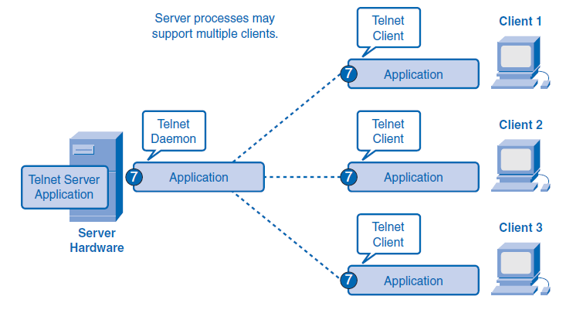
3. Making Provisions for Applications and Services
Outline
Application Layer Services and Protocols
A single application can employ many different supporting application layer services. Thus, what appears to the user as one request for a web page might, in fact, amount to dozens of individual requests. For each request, multiple processes can be executed.

Slide 15
3. Making Provisions for Applications and Services
Outline
Peer-to-Peer (P2P) Networking and Applications
In addition to the client/server model for networking, there is a peer-to-peer (P2P) model. P2P networking involves two distinct forms: peer-to-peer network design and peer-to-peer applications. Both forms have similar features but in practice work very differently.
P2P Networks
In a peer-to-peer network, two or more computers are connected through a network and can share resources such as printers and files without having a dedicated server. Every connected end device, known as a peer, can function as either a server or a client. One computer might assume the role of server for one transaction while simultaneously serves as a client for another. The roles of client and server are set on a per-request basis.

Slide 16
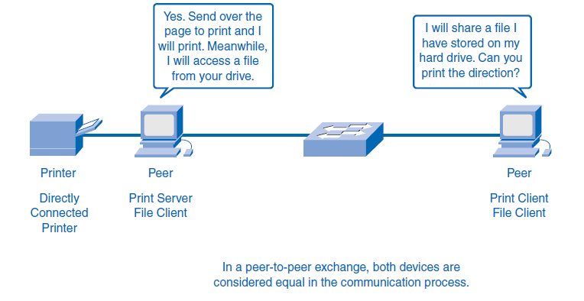
3. Making Provisions for Applications and Services
Outline

Slide 17
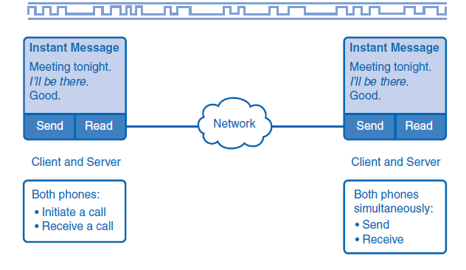
3. Making Provisions for Applications and Services
Outline
P2P Applications
A P2P application, unlike a peer-to-peer network, allows a device to act as both a client and a server within the same communication session. In this model, every client is a server and every server a client.
A type of peer-to-peer application is the P2P hybrid system, which utilizes a centralized directory called an index server even though the files being shared are on the individual host machines. Each peer accesses the index server to get the location of a resource stored on another peer. The index server can also help connect two peers, but after they are connected, the communication takes place between the two peers without additional communication to the index server. Peer-to-peer applications can be used on peer-to-peer networks, in client/server networks, and across the Internet.

Slide 18


THANK YOU

